Slide 1

Quasiparticle and electron-hole excitations in solids: theory and computation
(Part 1)
Peihong Zhang
Department of Physic, University at Buffalo

Slide 2
Outline
Quasiparticle concept, quasiparticle band structure and band gap
Quasiparticle equation, self-energy, and the GW approximation
First-principles GW method
Success and challenges of the GW method

Slide 3

Materials properties from first-principles
- A Hard Problem
"The underlying physical laws necessary for
the mathematical theory of a large part of
physics and the whole of chemistry are thus
completely known, and the difficulty is only
that the exact application of these laws leads
to equations much too complicated to be soluble.”
- Paul Dirac (1929)

Slide 4
The many-body problem
The Hamiltonian of a solid (any solids) is “trivial”
But solving the Schrodinger equation for a solid is hopelessly difficult
The use of the Born-Oppenheimer approximation decouples the motion of electrons from that of atoms, but we still have a many-electron problem
+
+
+
+
+
+
+
+
+
+
+
+
+
+
+
+
+
+
Electron coordinates
Ion coordinates

Slide 5

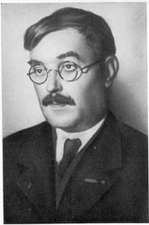

Materials properties from first-principles: Difficulties and efforts
Early efforts:
- Hartree approximation:
- Hartree-Fock:
- Slater: Replaces the nonlocal exchange with a local potential
All these efforts relay on the wave functions.

Slide 6
Density functional theory (DFT)
X
In a paper published in 1964, Hohenberg and Kohn proved that the energy of a many-electron system is a universal functional of its charge density
In particular, the ground state energy of a many-electron system can be expressed as a universal functional of its ground state charge density
The proof of this highly nontrivial fundamental theorem turns out to be surprisingly simple.
(Ground state energy)

Slide 7

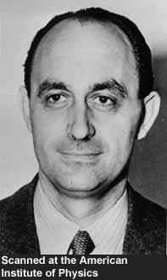

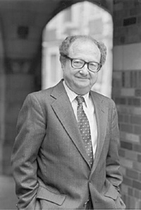


Density Functional Theory: Electron Density as a Fundamental Variable
In fact, the concept of “density functional” can be traced back to 1920’s.
- In the Thomas-Fermi method, the electron density plays a central role.
The Slater Xa potential can be regarded as an early version of LDA.
DFT: Hohenberg and Kohn, 1964
- The local electronic charge density can serve as a fundamental
variable for solving many-body problems.
Local density approximation (LDA): Kohn and Sham, 1965
- Makes DFT useful and has been applied to various systems with great success.

Slide 8
The DFT band gap problem
The success of the DFT-LDA is rather unexpected
The "failure" of DFT-LDA: the DFT bandgap “problem”
The occupied band width of Na is significantly overestimated
- 3.2 eV (LDA) vs 2.5 eV (exp)
"we do not expect an accurate description of the chemical bonding” (within the LDA). - Kohn and Sham, 1965
 | LDA(eV) | Exp (eV)
diamond | 3.9 | 5.48
Silicon | 0.52 | 1.17
Germanium | ~0 | 0.74
LiC | 6.0 | 9.4
KS orbital energies are fictitious parameters; they cannot be interpreted as the quasiparticle energies.

Slide 9
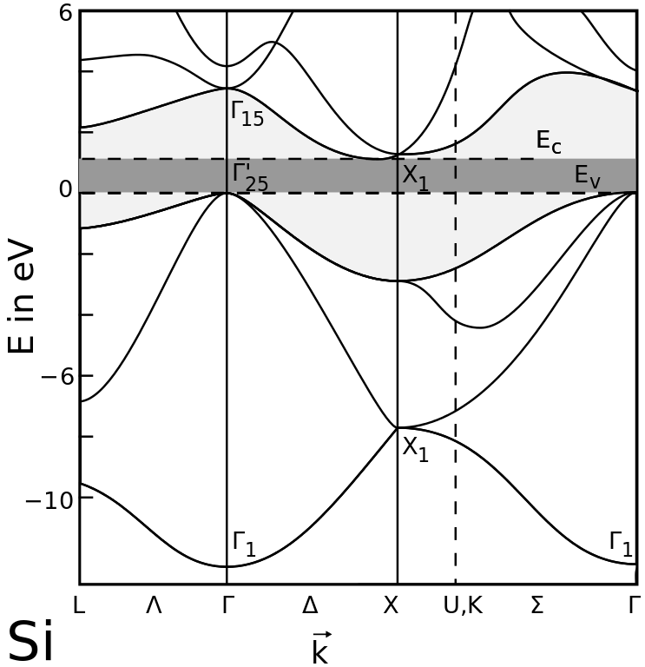
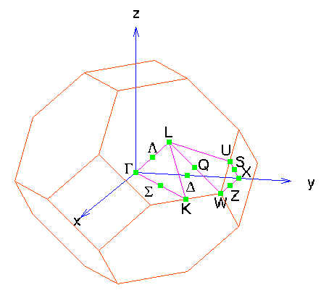
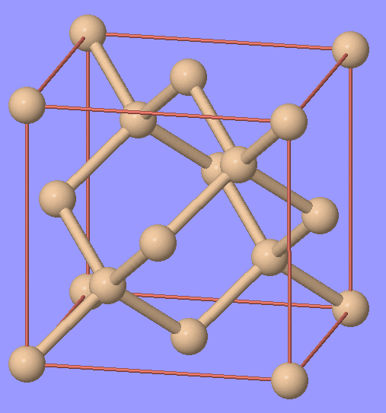
But what is the (quasiparticle) band gap
Take, for example, a band structure of Si (often calculated using DFT methods)
We can “calculate” the direct gap at Γ, indirect minimum gap, etc, by taking the energy difference between valence and conduction states
What about experiment? How do we measure the “band gap”, or more general, how do we measure the band structure of a solid?
What are quasiparticles?

Slide 10
Quasiparticles
In an interacting system (e.g., electrons in a solid), what is the meaning of one-particle states?
Consider an electron moving in a solid: Electron will considerably distort the charge distribution of its surrounding as it moves.
(1) Pauli exclusion principle (exchange hole, or fermi hole)
(2) Coulomb repulsion (Coulomb hole, or correlation hole)
(3) Electron will also cause distortions of ions (lattice)
All these effects (interactions) introduce a positive charge cloud (or depletion of negative charge), i.e, a hole, around an electron
+
−

Slide 11
Quasiparticles and the self-energy
We are not dealing with just a bare electron but an electron dressed with a positive polarization cloud
The quasiparticles energy now has both real and imaginary parts:
Quasiparticle:
electron + polarization cloud
QP energy:
non-interacting + self-energy
+
−
−
How do we measure these quasiparticle states?
How do we calculate this self-energy

Slide 12
Measuring the (quasiparticle)band structures
How do we measure “band structures”?
Occupied (valence) states
Unoccupied (conduction) states
N to N-1 particles
N to N+1 particles

Slide 13
What is the (qusiparticle) band gap?
Quasiparticle energy of occupied state s:
Quasiparticle energy of unoccupied state s:
(minimum) Quasiparticle band gap
The quasiparticle gap is actually related to the total energies of three different systems with N, N-1, and N+1 particles!
Clearly, one cannot use the Kohn-Sham DFT eigen values to calculate the quasiparticle band gap (or more general, the quasiparticle band structure)

Slide 14
Quasiparticle gap of a hydrogen atom
For a hydrogen atom:

Slide 15
Outline
Quasiparticle concept, quasiparticle band structure and band gap
Quasiparticle equation, self-energy, and the GW approximation
First-principles GW method
Success and challenges of the GW method

Slide 16
Green function
Green function (GF) contains spectral information on single-particle excitations changing the number of particles by one:
With quasiparticle amplitudes:

Slide 17
Green function
The poles of the GF give the corresponding excitation energies.
The spectral function
gives the quasiparticle density of states (DOS)
For non-interacting systems (like KS systems), the spectral function is just the DOS calculated from the KS eigen states.

Slide 18
Dyson equation and self-energy
The Dyson equation: Relation between the bare and dressed propagators and the self-energy
G₀ is just the propagator of the non-interacting particle
And G is call full propagator

Slide 19
Quasiparticle equation
Another form of Dyson equation: Quasiparticle equation
The self-energy contains all effects of e-e interactions
Compare with the Kohn-Sham equation
One of the difficulties of quasiparticle calculations is that the self-energy is nonlocal, non-Hermitian, and energy dependent.
Approximation to the self-energy:
- The Hartree-Fock approximation:
- The LDA approximation:

Slide 20
The Hedin equations for the self-energy
Hedin's equations for the self-energy
- Has to be solve iteratively (self-consistently)
- Extremely difficult!
Self-energy
Screened Coul.
Polarizability
Vertex function
2
1
2
1
Hedin, Phys. Rev. 139 A796 (1965)

Slide 21
The GW approximation
The GW approximation:
2
1
2
1

Slide 22
The G⁰W⁰ approximation
Still, G is the fully-interacting one-body Green function; one still has to solve the following equations self-consistently (and it turns out to be a bad idea to do so):
The G⁰W⁰ approximation
Best G, best W
2
1
2
1

Slide 23
Outline
Quasiparticle concept, quasiparticle band structure and band gap
Quasiparticle equation, self-energy, and the GW approximation
First-principles GW method
Success and difficulties of the GW method

Slide 24
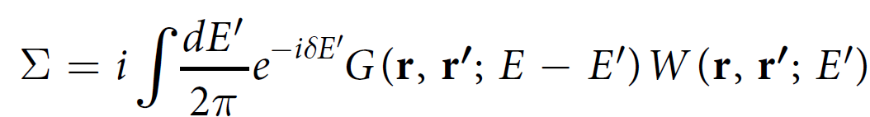
First-principles GW method
RPA
KS mean-field
calculation
Dielectric function
One particle Green function G
Self-energy
Hybertsen and Louie, 1986

Slide 25
First-principles GW method
Formally, the electron self-energy within the GW approximation can be written as
The screened Coulomb interaction in momentum space:

Slide 26
First-principles GW method
A critical step in first-principles GW method is the calculation of the dielectric matrix, therefore the screened Coulomb interaction W
In the exercise, we will not calculate the full frequency-dependent dielectric matrix (or screened Coulomb interaction).
Instead, we will use the so-called Hybertsen-Louie generalized plasmon pole (HL-GPP) model to extend the calculated static dielectric matrix to finite frequencies
More details can be found in
PRB 34, 5390 (1986)
Compt. Phys. Commun. 183, 1269 (2012)

Slide 27
First-principles GW method
The static dielectric function is related to the (irreducible) electron polarizability
via
where
and are the KS eigenvalue and the Fermi occupation
function of state

Slide 28
First-principles GW method
We have now all ingredients to calculate the electron self-energy
The quasiparticle energy of a given state:
Still, the self-energy has to be calculated at the quasiparticle energy, which we do not know until we calculate the self-energy!
If the self-energy is a slow-varying function of ω, we can carry out a first-order expansion:
where
and
is called quasiparticle renormalization factor

Slide 29
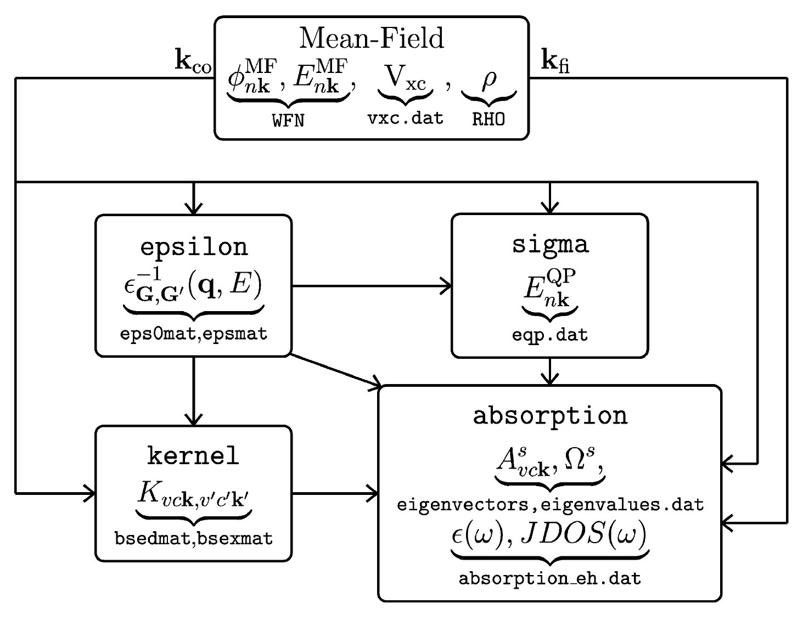
The BerkeleyGW package (https://berkeleygw.org/)
later
Computer Physics Communications 183, 1269 (2012)
Notes:
29

Slide 30
Outline
Quasiparticle concept, quasiparticle band structure and band gap
Quasiparticle equation, self-energy, and the GW approximation
First-principles GW method
Success and challenges of the GW method

Slide 31
Success of the GW method
W
G
 | LDA (eV) | GWA^{(a)} (eV) | Exp (eV)
diamond | 3.9 | 5.6 | 5.48
Silicon | 0.52 | 1.29 | 1.17
Germanium | ~0 | 0.75 | 0.74
LiC | 6.0 | 9.1 | 9.4
Typical accuracy of ab initio G⁰W⁰ methods: ~ 0.1 – 0.2 eV
Hedin, 1965; Hybertsen and Louie, 1986
Notes:
To calculate the quasiparticle properties, we need to evaluate the electron self-energy. Currently, this is done within the so-called GW approximation. In GW approximation, the electron self-energy is approximated as the product of Green function (G) and screened Coulomb interactions (W).

Slide 32
Not all materials are “GW friendly”
The band gap of InN was found to be 0.7 ~ 0.8 eV in 2002!
By experimentalists!!! Previously “accepted” value was 1.9 eV
- What have theorists been doing???
ZnO: LDA band gap: 0.7 eV
- Earlier GW calculations by several groups: 1.5 ~ 2.5 eV
- Experimental gap: ~ 3.6 eV
CuCl: LDA band gap: 0.32 eV
- “Straightforward” GW calculations give Eg < 2.0 eV
- Experiment: 3.4 eV
GWA does not work for these materials?
The devil is in the detail: Convergence behavior of several
truncation parameters has to be carefully examined!

Slide 33
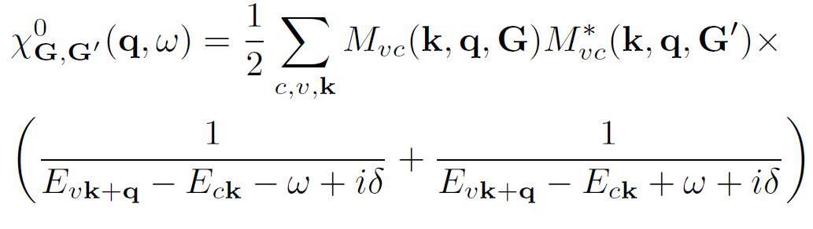
The dielectric function
The dielectric function:
Two truncation parameters in practical calculations
- Number of conduction bands (Nc) included in the summation
- Kinetic energy cutoff (G_{cut}) for the dielectric matrix
In practical calculations, truncations are almost always applied
- Nc number of conduction bands needed to converge the GW
results scales with the system volume
- Nc and anc G_{cut} are both highly materials dependent

Slide 34
The Coulomb-hole self-energy
The self-energy is usually decomposed into two terms
where
- The summation in principle should include all conduction bands

Slide 35
Convergence issues in GW calculations
Two important cutoff parameters:
- Band summation
- Kinetic energy cutoff of the dielectric matrix
The convergence issue in GW calculations is well recognized but often “ignored” (sometimes intentionally)
- Hard to perform convergence tests for all GW calculations
- For some materials (e.g., Si, Ge), GW results may converges
quickly
- For others (e.g. ZnO, MgO, CuCl), unconverged results may
lead to false predictions and/or wrong interpretations

Slide 36
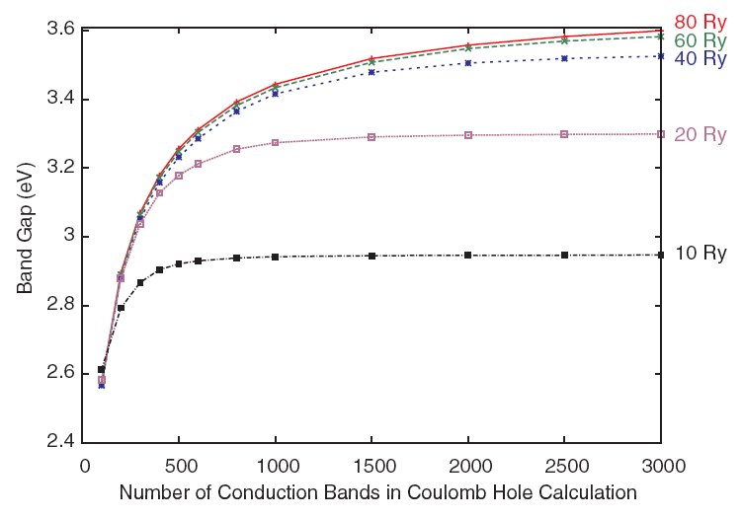
Quasiparticle Gap of ZnO (LDA+U/GW)
experiment
Previous result
A small kinetic energy cutoff for the dielectric matrix leads to a false convergence behavior
PRL 105, 146401 (2010)

Slide 37
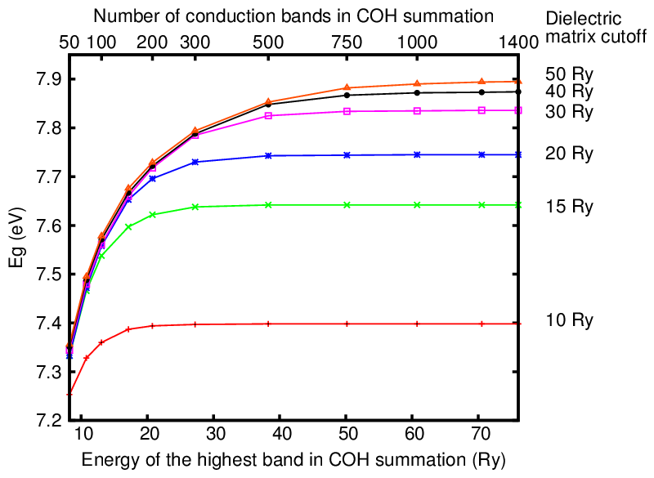
Quasiparticle gap of MgO
Previous results
Scientific Reports 6, 36849 (2016).

Slide 38
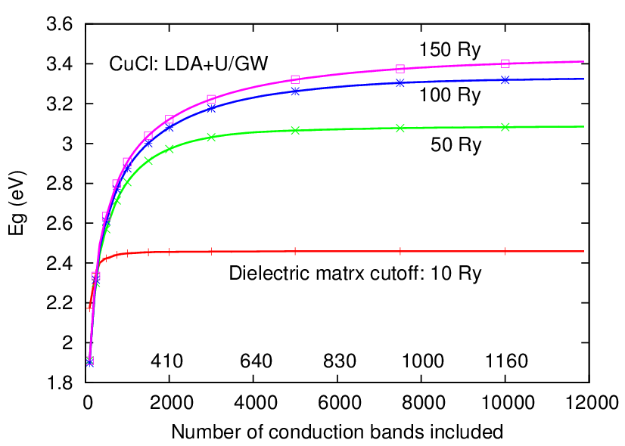
Quasiparticle gap of CuCl
experiment
A few hundred bands
10,000 bands for a two-atom system!?
PRB 98, 045108 (2018)

Slide 39
Systems with d-states
GW calculations for systems involving localized d states and oxides are particular challenging due to the computational costs (high cutoffs and large number of bands), the slow convergence, and the poor DFT description of the correlated d electrons
Fortunately, with our newly developed accelerated methods (more later) and the development of combined DFT+U and GW, we are now able to accurate predict the quasiparticle properties of oxides (ZnO discussed earlier, SrTiO3, BaTiO3, SrZrO3, etc)

Slide 40
Systems with d-states

Slide 41
Quasiparticle band structures of STO and BTO

Slide 42
Systems with d-states

Slide 43
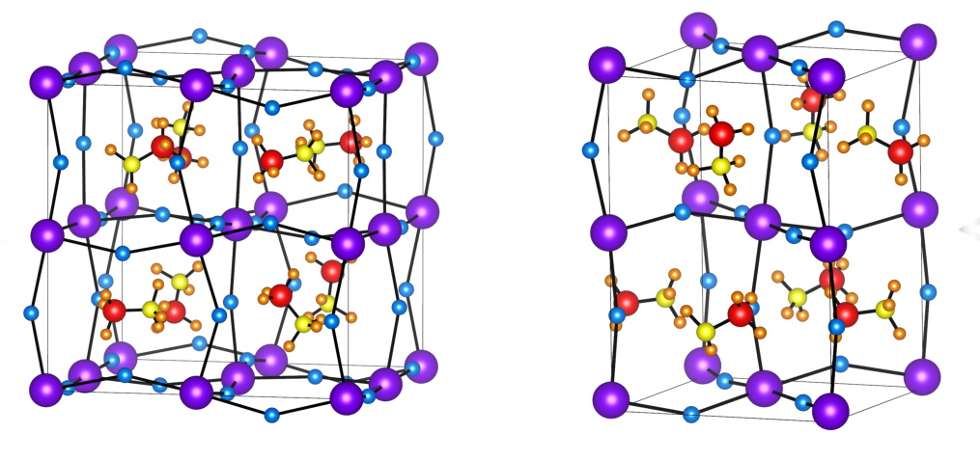
Hybrid organic-inorganic perovskites
One of the difficulties of calculating the quasiparticle properties of hybrid perovskites is random orientations if the organic molecule and the structure distortions – need large unit cells and average over many distorted structures

Slide 44
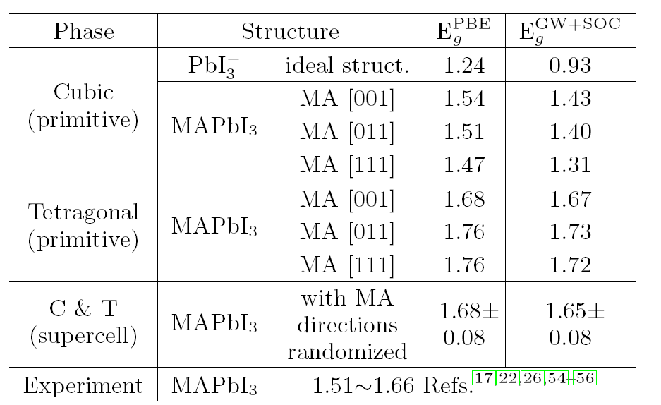
Quasiparticle band gap of MAPbI3
PRB 93, 085202 (2016)

Slide 45
GW calculations for large systems?
High-throughput GW calculations?
(Forget about ZnO or CuCl) For a 2-atom MgO, we need about 1,000 conduction bands to converge the result
Suppose we are interest in a system containing 200 atoms
(e.g, a supercell containing a defect), we will need
to achieve the same level of convergence
Not only calculating the wave functions is hard (if possible), but storing these wave functions is extremely problematic, not to mention the subsequent GW calculations

